Slide 1
Assignment 1-Implementation of Backpropagation and Training a Palindrome Network
Abhishek Anand, 200260002
Kapil Bhagat, 200260022
Nirmal Solanki, 200260034

Slide 2
Problem Statement
Check if 10-bit string is palindrome or not
Let’s take example of 10 bit string:
“1000000000” : Not Palindrome
“1000110001” : Palindrome
“0000000000” : Palindrome
“0101010101” : Not Palindrome
We have generated all the possible combinations of 10 bit string from only [0,1] using iterator that generates each combination i.e. 1024
Technique to be used: Neural network (BP from scratch)

Slide 3
Problem Statement
Input: 10-bit String (of numbers)
The Input will be vector of 10-bit string of numbers like [“1010101010”, “1010000101”,....]
Output: Palindrome or not (class 0 or 1)
Output will be binary 0 and 1, 0 for not Palindrome, and 1 for Palindrome

Slide 4
Input representation
<Describe how you represent number while feeding to NN>
The total number of 10 bits combinations from [0,1] will be 1024.
So the Input will be a vector of size 1024 x 10, where 10 is the l length of each string like this:
[[0,0,0,0,0,0,0,0,0,0], [0,0,0,0,0,0,0,0,0,1], [0,0,0,0,0,0,0,0,1,1],............,[1,1,1,1,1,1,1,1,1,1]]
The input layer is of size 10.

Slide 5
Input representation
The neural network will look like this:
1
0
1
1
0
1
1
0
0
1
Input Layer: 10
Hidden Layer: 5(it is not minimum)
Output Layer: 1
Output Layer
Hidden Layer
Input Layer

Slide 6
BP implementation
< Important: Details of backpropagation implementation. Including mathematical and hyperparameter details>
Mathematical Details:
Backpropagation involves two main steps: forward propagation and backward propagation.
Forward Propagation: In this step, the input data is passed through the network to make predictions. The output of each layer is computed based on the weights and biases of that layer and passed through an activation function.
Backward Propagation: This step calculates the gradients of the loss function with respect to each parameter in the network, starting from the output layer and moving backward to the input layer. These gradients are then used to update the parameters in the direction that minimizes the loss.

Slide 7
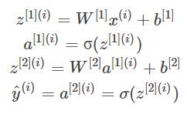
BP implementation
Let's break down the mathematical details of backpropagation:
Forward Propagation:
Where x(i) is the input, W1: weight vector from Input layer to hidden layer, W2: weight vector from hidden layer to output layer, b1: bias vector from input layer to hidden layer, b2: bias vector from hidden layer to output layer.
σ : sigmoid activation function
a[1] is output of hidden layer
a[2] is output of output layer

Slide 8

BP implementation
Cost Function: Here I am using binary cross entropy loss function

Slide 9
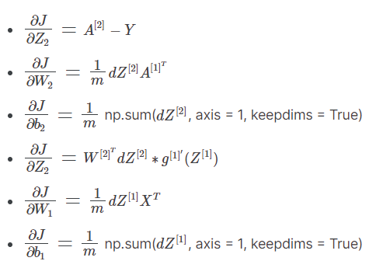
BP implementation
Backpropagation:

Slide 10
BP implementation used Functions
In the final code we have implemented various functions like:
sigmoid(z)
layer_sizes(X,Y),
initialize_params(num_input,num_hidden,num_output)
forward_propagation(X,W1,b1,W2,b2), compute_cost(Y,A2)
backward_propagation(X,Y,W1,b1,W2,b2,Z1,A1,Z2,A2)
update_params(W1,b1,W2,b2,dW1,db1,dW2,db2,learning_rate)
neural_network(X,Y,num_hidden,learning_rate,param_list,num_iterations)
predict(W1,b1,W2,b2,X)
where z = W^T.X + b, X is features, Y is labels, num_input = # of neurons in input layer, num_hidden = # of neurons in hidden layers, num_output = # of neurons in output layer, W1, b1 are weights and bias vector from input layer to hidden layer, W2, b2 are weights and bias vector from hidden layer to output layer, A1 and A2 are output from hidden and output layer respectively, dW1, dW2, db1, db2 are the changed values in weights and biases. param_list contains the final trained weights and biases values.

Slide 11
BP implementation used Hyperparameters
We are using sigmoid as the activation function, 1 input layer with 10 neurons, 1 hidden layer and 1 output layer.
For this Palindrome Network, We have checked the minimum number of neurons to solve this problem and we got required result by using 4 neurons in hidden layer but we used 5 neurons for a better result and on using 7 neurons we got overfitted result.
The hyperparameters used in implementing this neural network are:
learning_rate = 0.1
num_iterations(Epochs) = 2000
num_input = 10
num_hidden = 5
num_output = 1
K-fold = 4

Slide 12
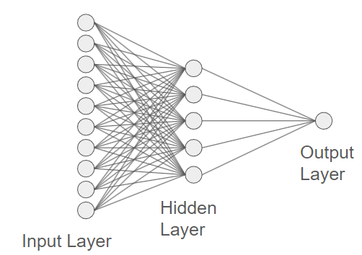
Architecture details
The neural network architecture will look like this:
1
0
1
0
1
0
1
0
1
0
W1,b1
x(i)
A2
NN
W2,b2
A2-y(i)
0
1
Backward
propagation

Slide 13
Architecture details
Input layer contains 10 neurons, each neurons for each bits of string(“1000110001”), where this string is further converted into array [1,0,0,0,1,1,0,0,0,1]. So the total size of Input dataset become 1024X10.
The weights W1, W2 and biases b1, b2 are randomly generated in the first step of first iteration, which is computed by initialize_params() function.
After that in forward_propagation() function the z1 is computed as W1.X + b1 is being computed and then feed to sigmoid() activation function to get output as A1.
A1 is the output of hidden layer in first iteration, then A1 is being input to the output layer and z2 is being computed from forward_propagation() function then it is again fed to sigmoid() to get A2. A2 is the final output of forward propagation in first iteration.

Slide 14
Architecture details
The binary cross entropy loss is being computed through compute_cost() function.
Then after the loss computation, now backward_propagation() function begins to run, in this function we have calculated change in weights and biases dW2 and db2 w.r.t z2, and then dW1, db1 w.r.t z1 (which is being multiplied by derivative of sigmoid).
Now update_params() function will run to update the weights and biases for both from input to hidden and hidden to output layers.
This whole process will run till the last epoch and we will get the final weights and biases values. Then we predict the test data from predict() function.

Slide 15
Overall performance
Precision ~ 75%
Recall ~ 75%
F1-score ~ 75%
Avg. Accuracy ~ 99.22%

Slide 16
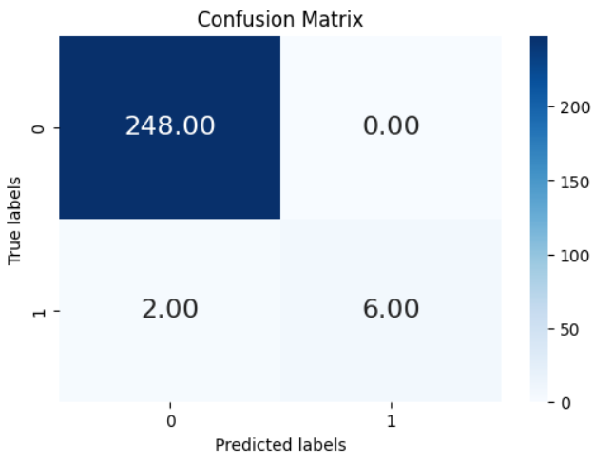
Confusion Matrix

Slide 17
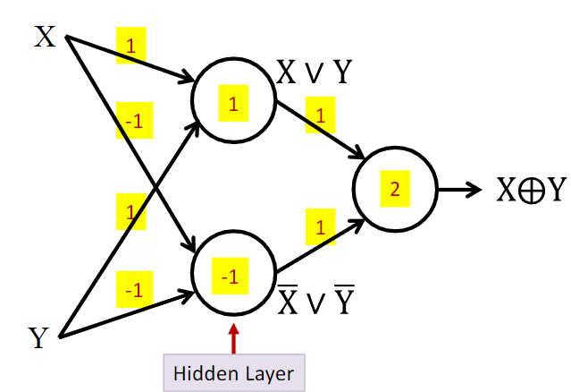
Interpretability of middle layer
<Try to reason the performance by finding what middle layer neurons are doing.>
<try giving reasons>
Considering the XOR function,a non-linearly separable function, a single linear decision boundary cannot correctly classify the input space. So the XOR function requires a hierarchical composition of features to be accurately represented. The XOR network needs two hidden neurons and one output neuron, because we need one hidden neuron for each of the two boundaries of the XOR region, and an output neuron to AND them.

Slide 18
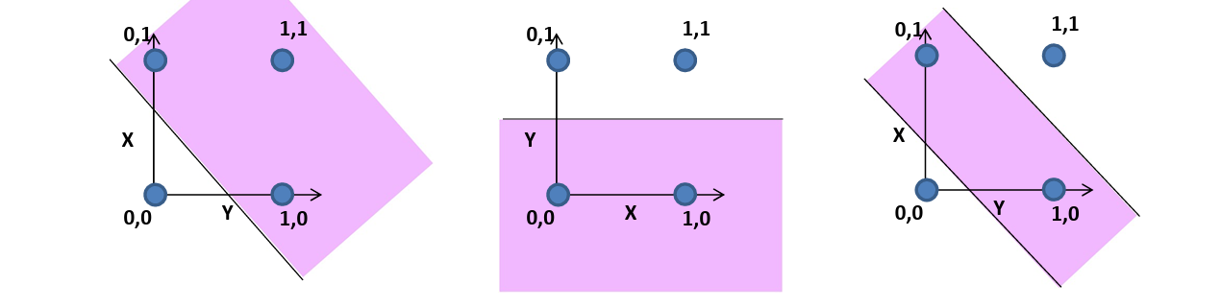
Interpretability of middle layer

Slide 19
Learnings
We learn:
Importance and working of Backward propagation in neural networks.
Importance of hidden layers and its # of neurons in neural networks, as in this problem F1, precision and recall decreases for # of neurons <4, and will cause overfitting for # of neurons >6.
Importance of learning rate, as the precision and recall value decreases for learning_rate < 0.1.
Importance of F1 score, precision and recall value for handling imbalanced dataset.
Importance of K-Fold cross validation, as decreasing the K-Fold number, decrease the precision and recall value.

